Slide 1
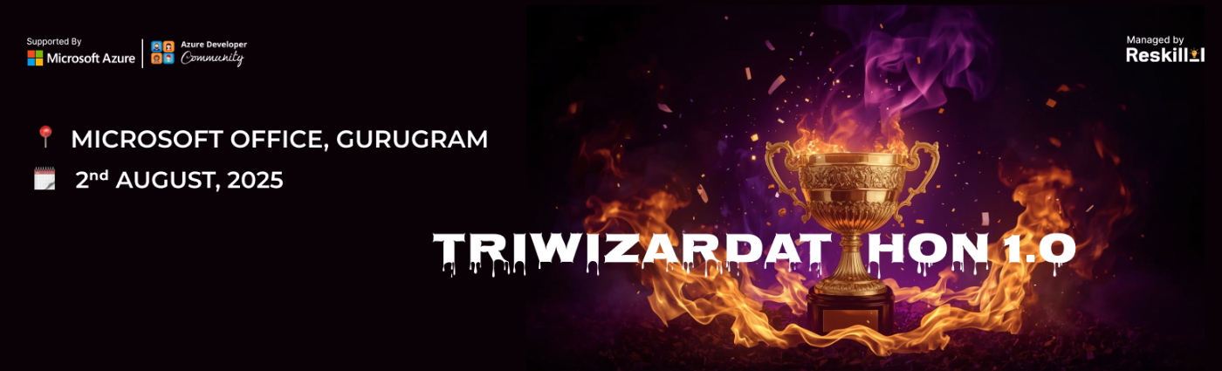
Team Members
Team Name : Binary Broomsticks
Team Leader Name : Survi Mukherjee
Problem Statement : Mentis Mirror “A Cognitive Digital Twin for Real-Time Emotion & Stress Detection” Combining IoT + AI for Human-Centric Wellness, Safety & Productivity

Slide 2
Contents
Sl. No | TITLE
1 | Problem Statement
2 | Proposed Solution
3 | Key Components
4 | System Architecture
5 | ML & AI Models – The Brain Behind Mentis Mirror
6 | Deployment Stack
7 | Cost Breakdown (Prototype)
8 | Key Features & Impact
9 | Conclusion

Slide 3
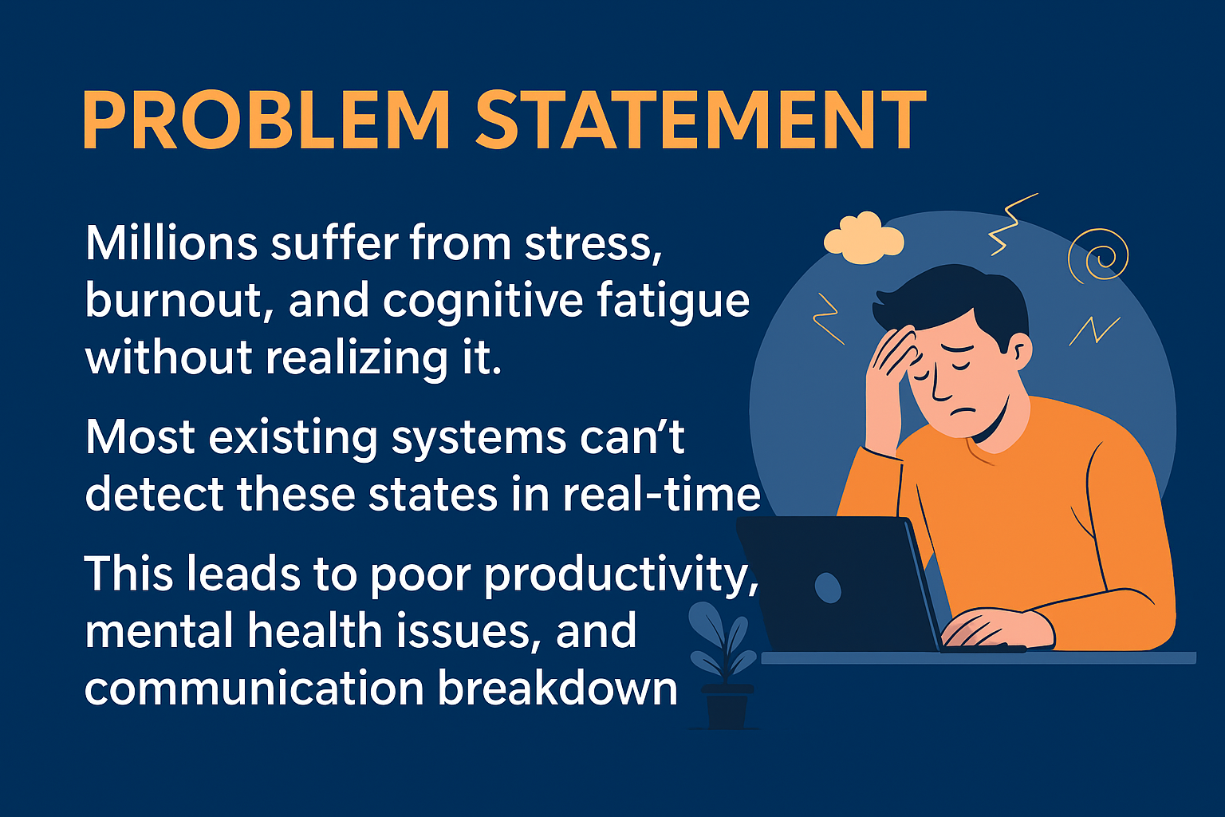

Problem Statement
🧩 The Core Problem: Modern individuals — especially students, developers, drivers, factory workers, and healthcare professionals — often suffer from hidden cognitive fatigue, stress, and emotional burnout, without clear external signs.
A student under exam pressure doesn't realize. rising cognitive stress until their performance drops.
💥 Why It Matters
⚠️ Consequences
🧍‍♀️ Invisible Decline in Mental Health People don't realize when their cognitive load becomes dangerous until performance drops, mistakes happen, or health suffers.
🕵️‍♂️ Lack of Real-Time Monitoring Current solutions (like wearables or wellness apps) are mostly reactive, not real-time, and focus only on physical vitals — not emotional well-being.
🔒 No Integration into Daily Life or Digital Ecosystems Even if mood is tracked, there’s no seamless way to make apps, calendars, or smart devices adapt to the user’s cognitive state.
⏰ Missed productivity opportunities due to unrecognized mental fatigue
💬 Poor communication in remote teams due to unnoticed stress
🚑 Burnout-related health issues go undetected until it’s too late
🔁 Non-personalized digital experiences — no tech understands how you actually feel

Slide 4
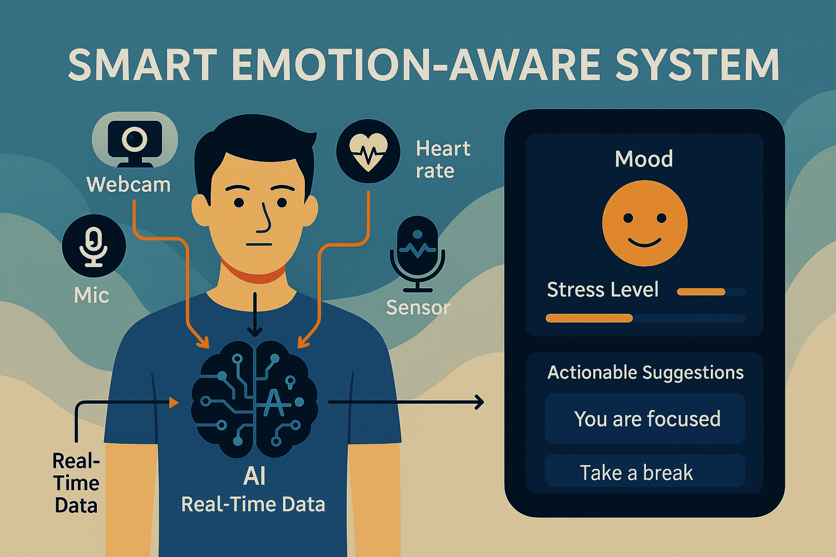
Proposed Solution
🔍 Overview: Mentis Mirror is a Neuro-AI powered IoT system that creates a digital twin of your emotional and cognitive state in real-time by continuously analyzing bio-signals, facial expressions, voice tone, and environmental factors. It’s a complete emotion-aware platform designed to enhance well-being, productivity, and human-computer interaction.
🔄 Multimodal AI Fusion: Combines physiological + emotional + contextual data
🧩 Personalized Digital Twin: Tracks your evolving mental state like a mirror of your mind
🚀 Real-Time Responsiveness: Alerts and adjusts environments instantly
💬 Microsoft Integration: Graph API and Azure ecosystem compatibility
💡 Non-invasive + Low Cost: Uses affordable sensors and open-source models
🧠 Key Capabilities
🧠 What Makes SynapSync Different?
🔬 1. Multimodal Sensing
Facial micro-expression detection using DeepFace/Azure Face API
Voice tone analysis to understand emotional intensity (calm, tense, angry, etc.)
Heart rate variability (HRV) and GSR (sweat) analysis to detect stress
Skin and ambient temperature sensing for physiological context
🧩 2. Cognitive State Estimation
Fuses data into a time-series model to understand:
Mood
Focus
Fatigue
Stress
Generates a real-time cognitive state vector, e.g.: Mood: Low | Focus: Medium | Stress: High | Suggestion: Take a Break
🔔 3. Real-Time Feedback Loop
Smart alerts via:
App notifications
Buzzer/vibration module
Dashboard suggestions
Responds with adaptive actions:
Reschedules meetings via Microsoft Graph API
Suggests music, break, lighting changes
Logs behavior for long-term patterns
Azure-Powered Cloud Integration
Data synced through Azure IoT Hub
Emotional state modeled with Azure Digital Twins
Azure ML optionally handles large-scale inference
Connects to Microsoft Graph API to interact with the user’s digital ecosystem (e.g., Outlook, Teams)

Slide 5
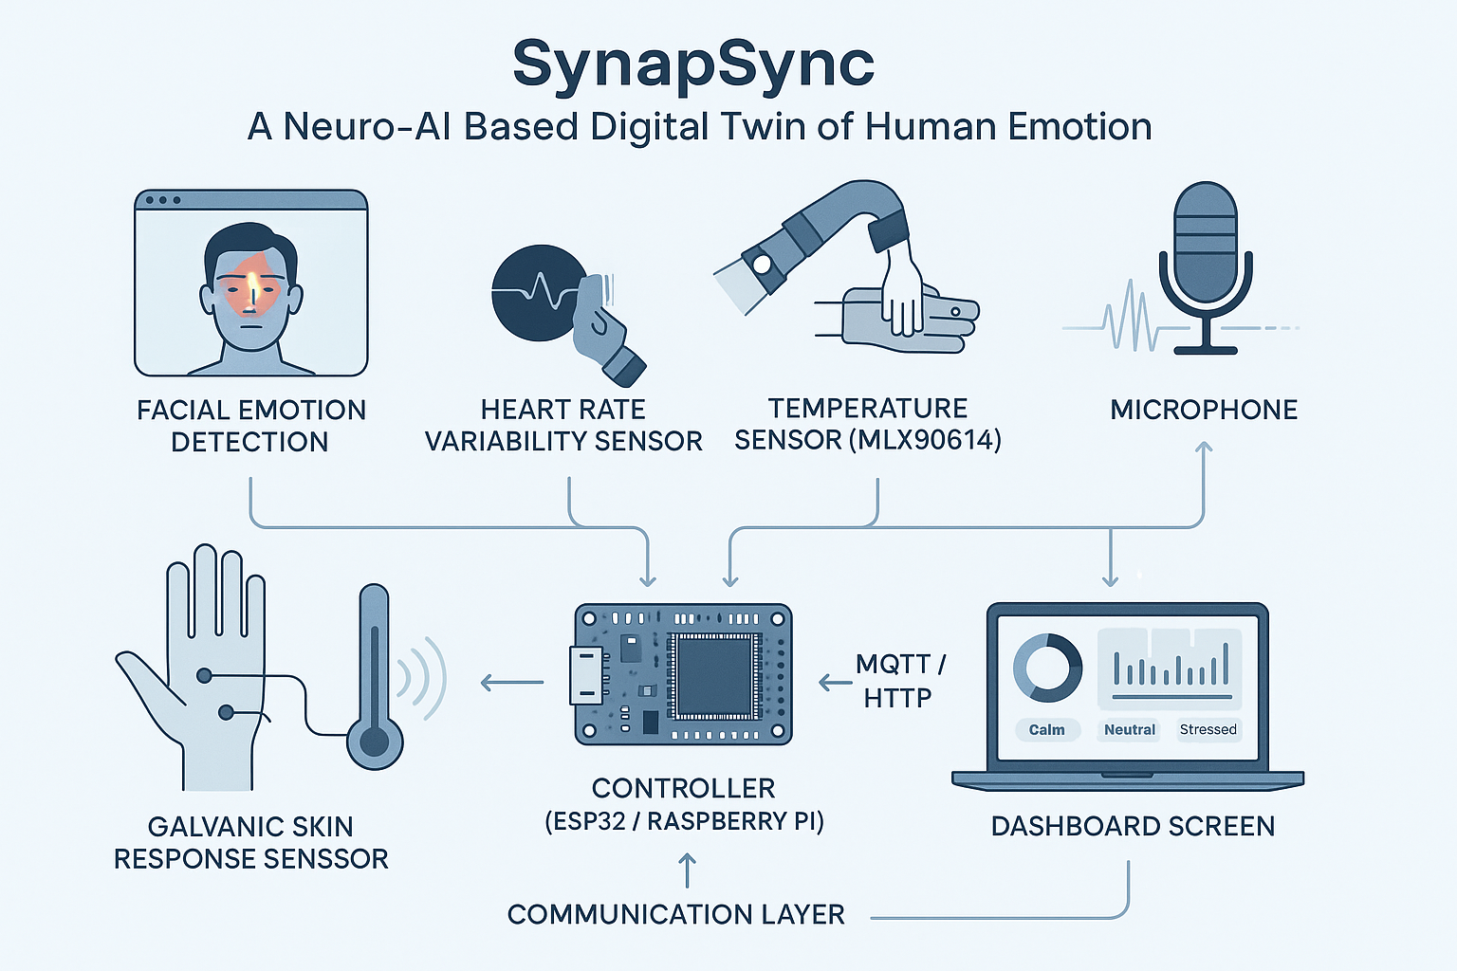
Key Components
🧠 Facial Emotion Detection (Webcam + DeepFace)
Captures micro-expressions, stress cues
Runs locally or via Azure Face API
Outputs emotions like Happy, Sad, Angry
🎯 Real-time emotion sensing from face
🎙️ Voice Sentiment (Mic)
Detects mood from tone, pitch, tempo
Works even without camera
🎯 Passive emotion recognition
Mentis Mirror (Latin: Mirror of the Mind):- Reflects your cognitive state instead of desires. “Gaze into it, and it gazes into you.”
Mentis Mirror
🔌 ESP32
Collects sensor data
Sends to API / processes locally
🎯 Real-time embedded processing
❤️ Heart Rate Sensor (MAX30102)
Measures HR + HRV
Detects hidden stress/cognitive load
🎯 Internal stress indicator
📡 Data Layer (Flask)
Aggregates signals
Generates live Digital Twin (JSON)
🎯 Central logic + model host
🤚 GSR Sensor
Tracks sweat gland activity
High GSR = high emotional arousal
🎯 Validates stress state
📊 Dashboard (Streamlit)
Live mood/focus/stress view
Logs trends + gives smart suggestions
🎯 User-facing insights & feedback
🌡️ Temp Sensor (MLX90614)
Monitors ambient & skin temp
Adds comfort/fatigue context
🎯 Often overlooked but vital input

Slide 6
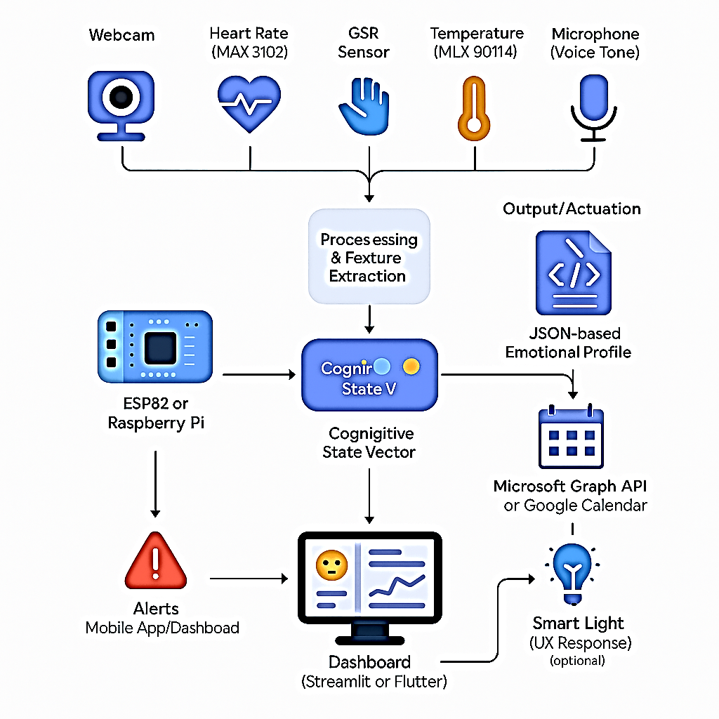
System Architecture
Detailed Flow
Simplified View
Provides a clear breakdown of each layer:
High-impact version for this architecture:
Data Acquisition – webcam, MAX30102, GSR, MLX90614, microphone
Processing & Fusion – ESP32/Pi → Flask/FastAPI → ML
Digital Twin – JSON-based emotional profile with optional cloud sync
Output & Actuation – Alerts, calendar/smart environment integration
Visualization – Real-time dashboard with mood/stress/focus analytics
Sensors collect multimodal data
ESP32/Pi sends it to ML backend
ML produces a JSON “cognitive twin”
Dashboard shows live trends & alerts
Optional calendar sync and smart adaptation
The Mentis Mirror system architecture consists of sensor modules (facial, heart rate, GSR, temperature, voice) connected to an ESP32 or Raspberry Pi, which transmits data to a backend for processing and emotion classification. A machine learning model fuses these signals into a real-time cognitive state, which is visualized through a dashboard and triggers smart alerts or adaptive actions.

Slide 7
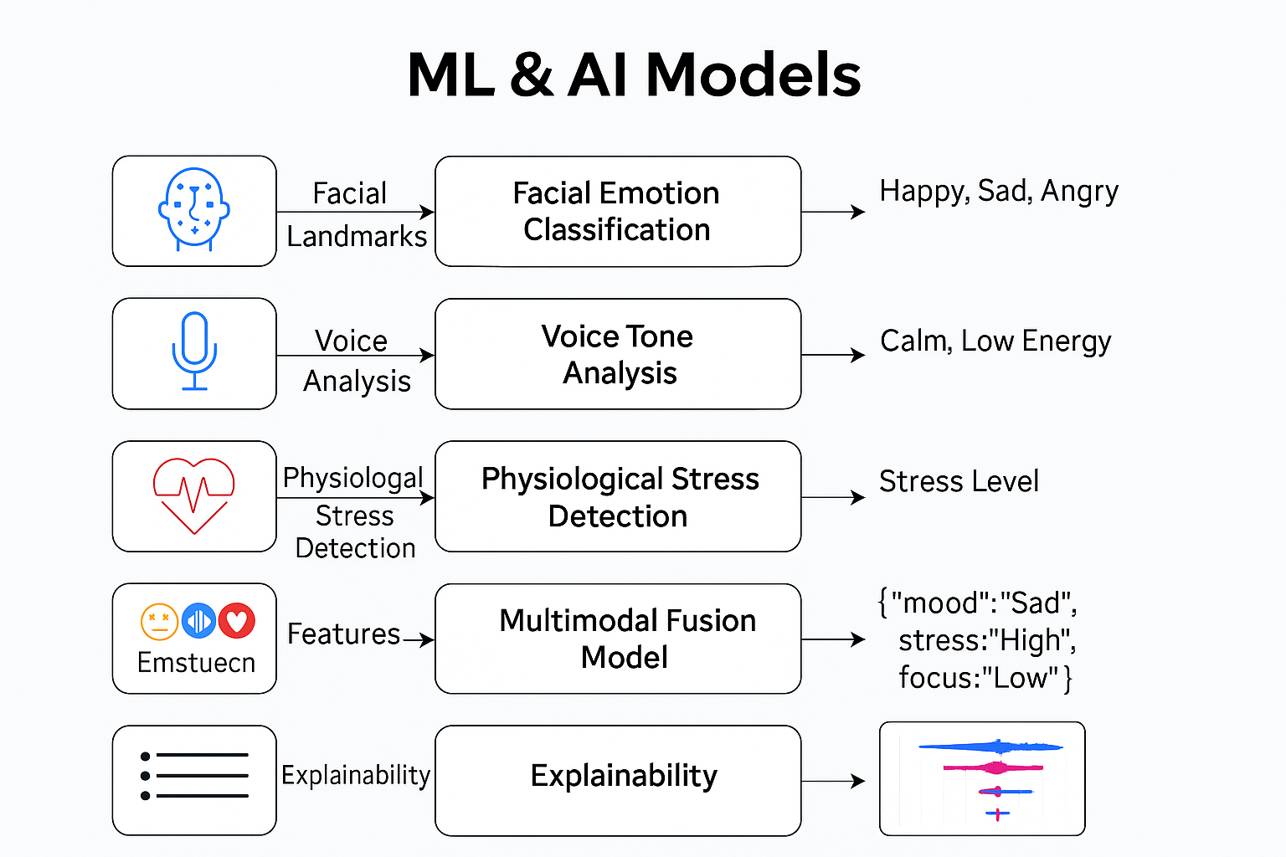
ML & AI Models – The Brain Behind Mentis Mirror
1. Facial Emotion Classification
DeepFace or CNN detects expressions like Happy, Sad, Angry, etc.
Real-time emotion detection from webcam feed.
2. Voice Tone Analysis
Uses Whisper + sentiment classifier (e.g., SVM/LSTM).
Extracts emotion from pitch, tone, tempo of speech.
3. Physiological Stress Detection
HRV (heart rate variability), GSR, and temperature analyzed.
ML model (Random Forest / LSTM) classifies stress levels.
4. Multimodal Fusion
Combines all data streams into a Cognitive State Vector.
Generates a JSON-based digital twin of emotional state.
5. Explainability
SHAP (SHapley Additive) explains feature importance.
Builds trust and interpretability into emotional predictions.

Slide 8
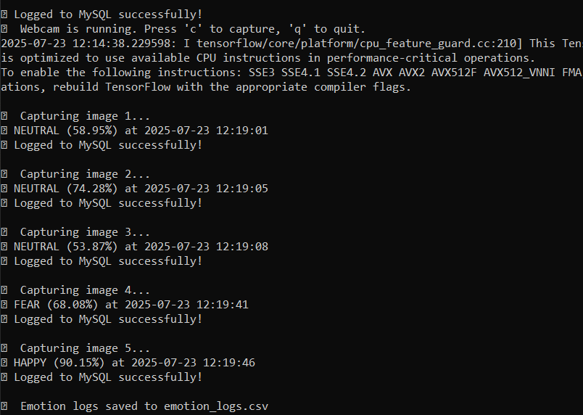
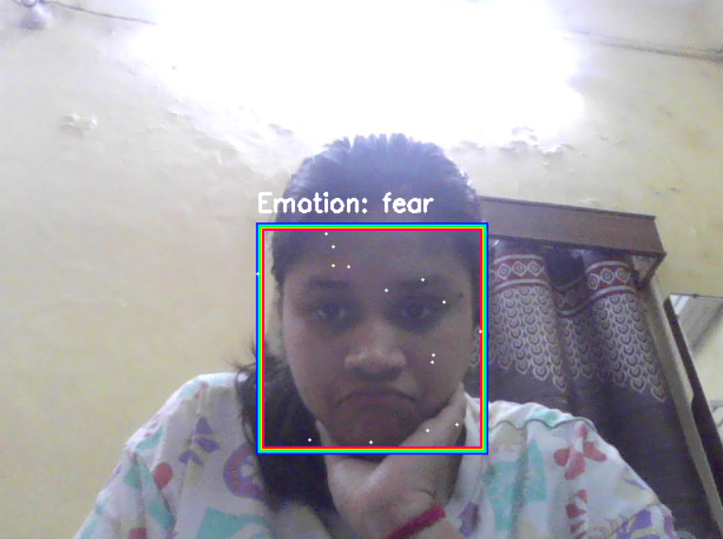
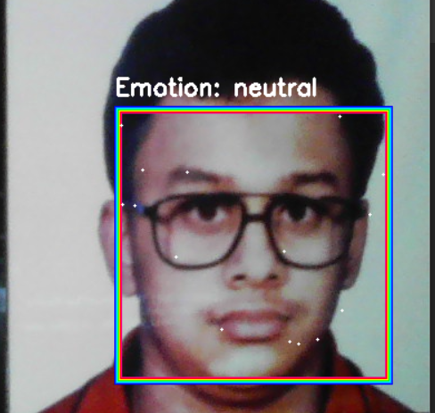
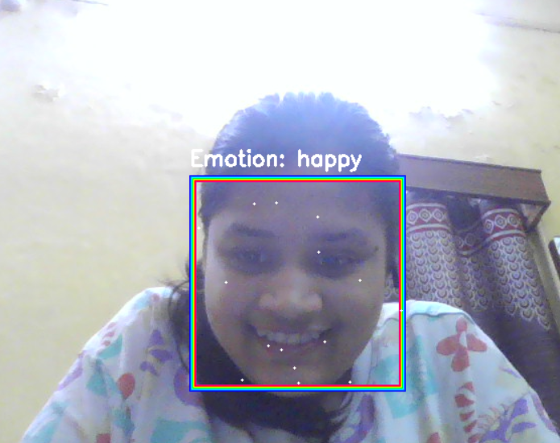
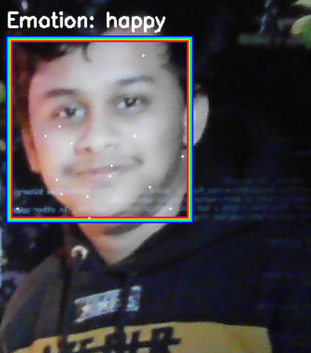
Facial Emotion Classification
✨ Mentis Mirror uses DeepFace to detect real-time facial emotions from webcam input. 💫 To enhance user experience, magical glowing lines dynamically appear above and below the face while displaying the detected mood with confidence.

Slide 9
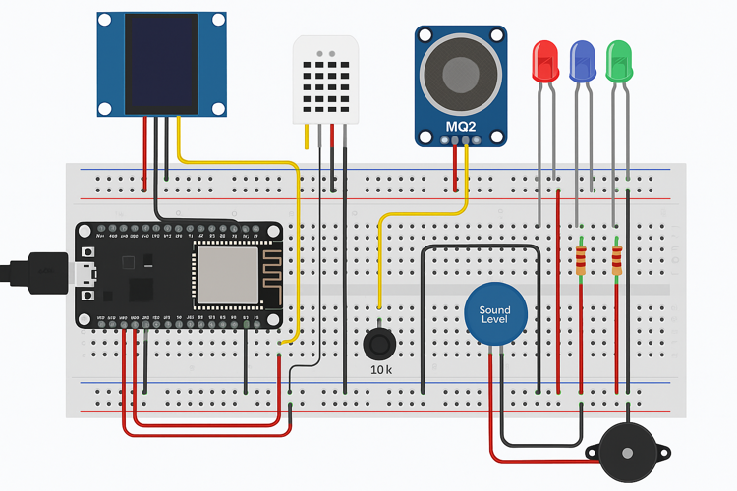
Sensor System Architecture 🌟- for Physiological Stress Detection
💻 Central Controller
📥 Input Sensors
📤 Output Components
🔌 Power Supply
🔄 Communication Flow
- ESP32 Dev Board
- Reads sensors, controls outputs
- 🌡️ DHT11 → GPIO2
- 💨 MQ2 → GPIO34
- 🎤 Sound Sensor → GPIO35
- ⬛ Button → GPIO15
- 🖥️ OLED → GPIO21(SDA), GPIO22(SCL)
- 🔴🟢🔵 LEDs → GPIO13/12/14
- 🔔 Buzzer → GPIO27
- USB 5V Power
- Red → VCC, Black → GND
Sensors → ESP32 → OLED/LEDs/Buzzer

Slide 10
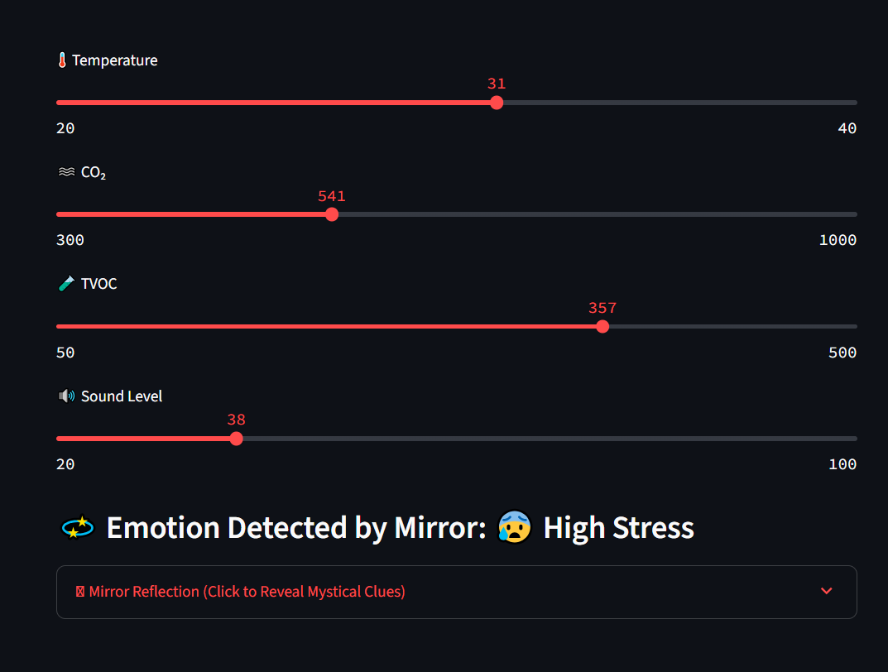
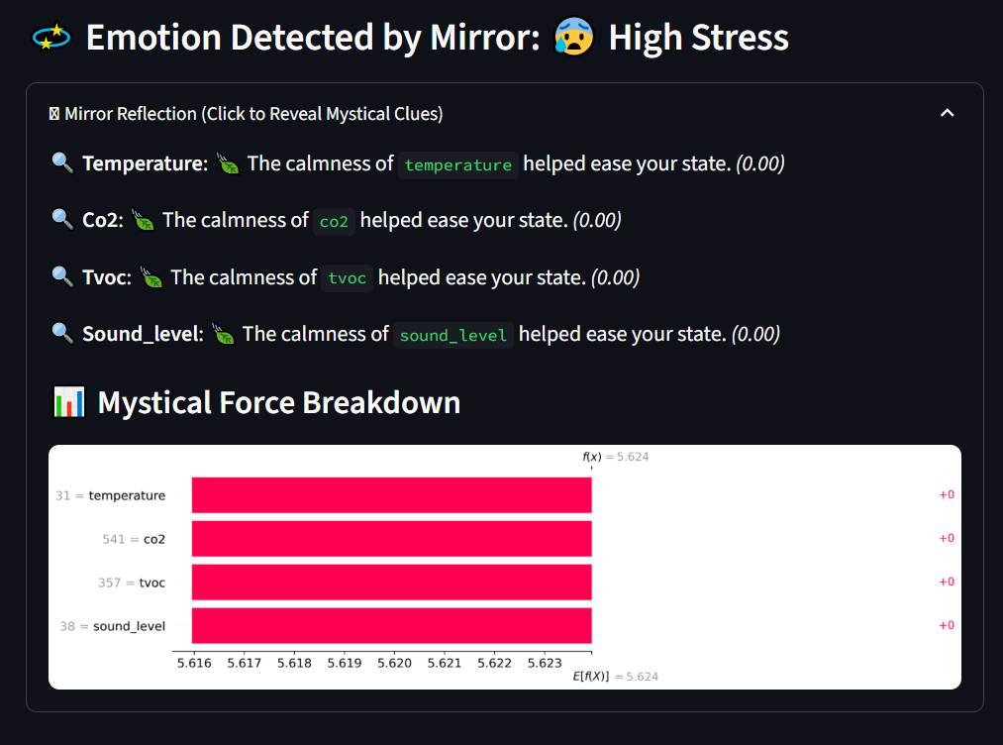
Explainability
📊 Why SHAP?
🧬 Feature Contribution Visuals
🔍 Transparent Predictions
🪄 Magic + Logic
📁 User Benefit
SHAP (SHapley Additive exPlanations) helps us understand why a particular emotion was detected by explaining each feature's impact on the model's output.
SHAP values highlight how factors like facial expressions (e.g., mouth openness, brow raise, eye squint) influence the emotion prediction.
Provides per-frame visual justification for the detected emotion — building trust in the AI system.
Blends the magic of emotion detection with the logic of feature attribution, reinforcing that Mentis Mirror is not just mystical, but also scientifically explainable.
Users can view which facial regions contributed most, making the system more interactive, educational, and emotionally intelligent.

Slide 11
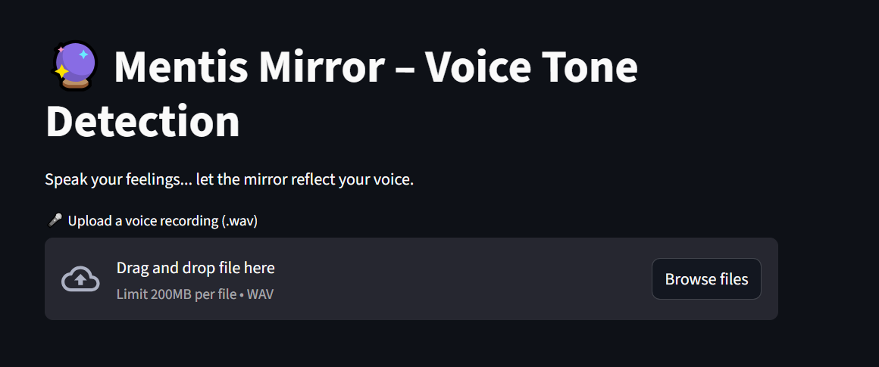
Voice Tone Analysis
🎯 Purpose
Identify emotional tone in voice recordings using AI
Allow users to speak their feelings to the mirror
A step toward multi-modal emotion detection
🛠️ How It Works
Users upload a .wav file (max 200MB)
Pre-trained ML model analyzes pitch, intensity, tone
Emotion categories: Happy, Sad, Angry, Neutral, etc.
Uses features like MFCC, Chroma, Zero-Crossing Rate
🔮 Future Scope
Combine voice tone + facial emotion for accurate predictions
Enable real-time voice emotion feedback
Integrate with magical item triggers based on voice mood

Slide 12
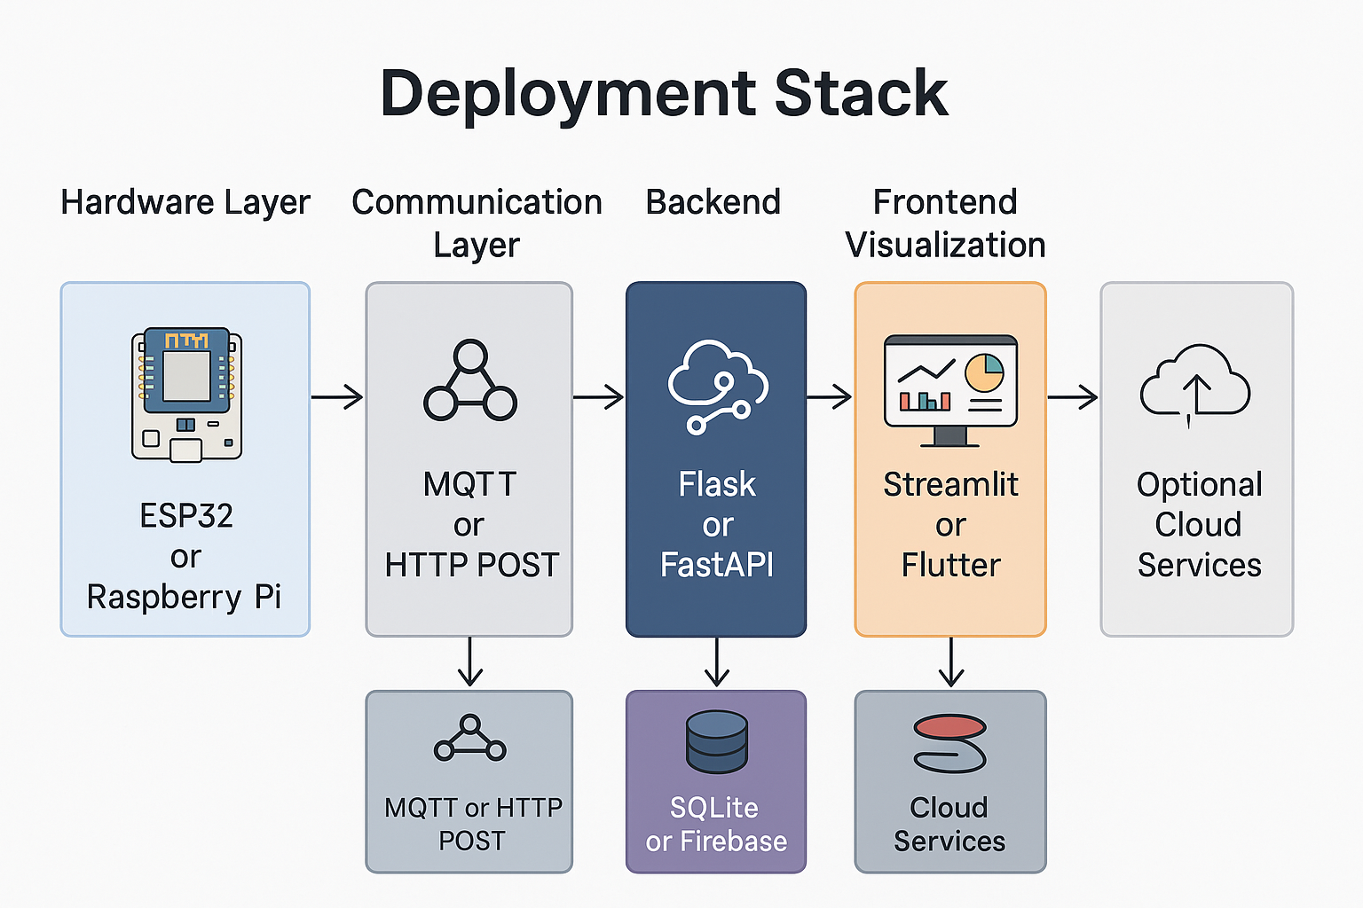
Deployment Stack
1. Hardware: ESP32 collects sensor data
2. Communication: HTTP POST sends data to backend
3. Backend: Flask handles data + ML inference
4. Database: SQLite logs emotional states
5. Frontend: Streamlit shows live cognitive insights
6. Cloud (Optional): Integrate with IoT Hub or Graph API

Slide 13
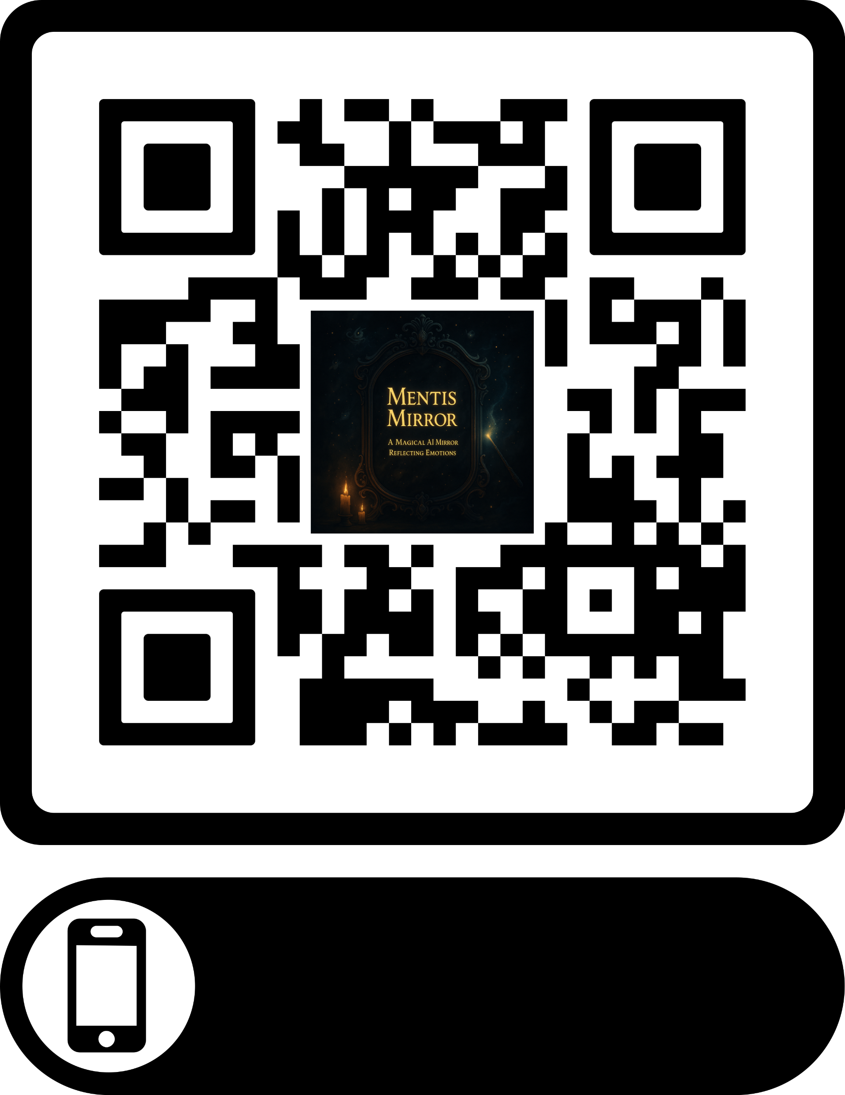
Please Scan to QR. Code to see the UI of our project.

Slide 14
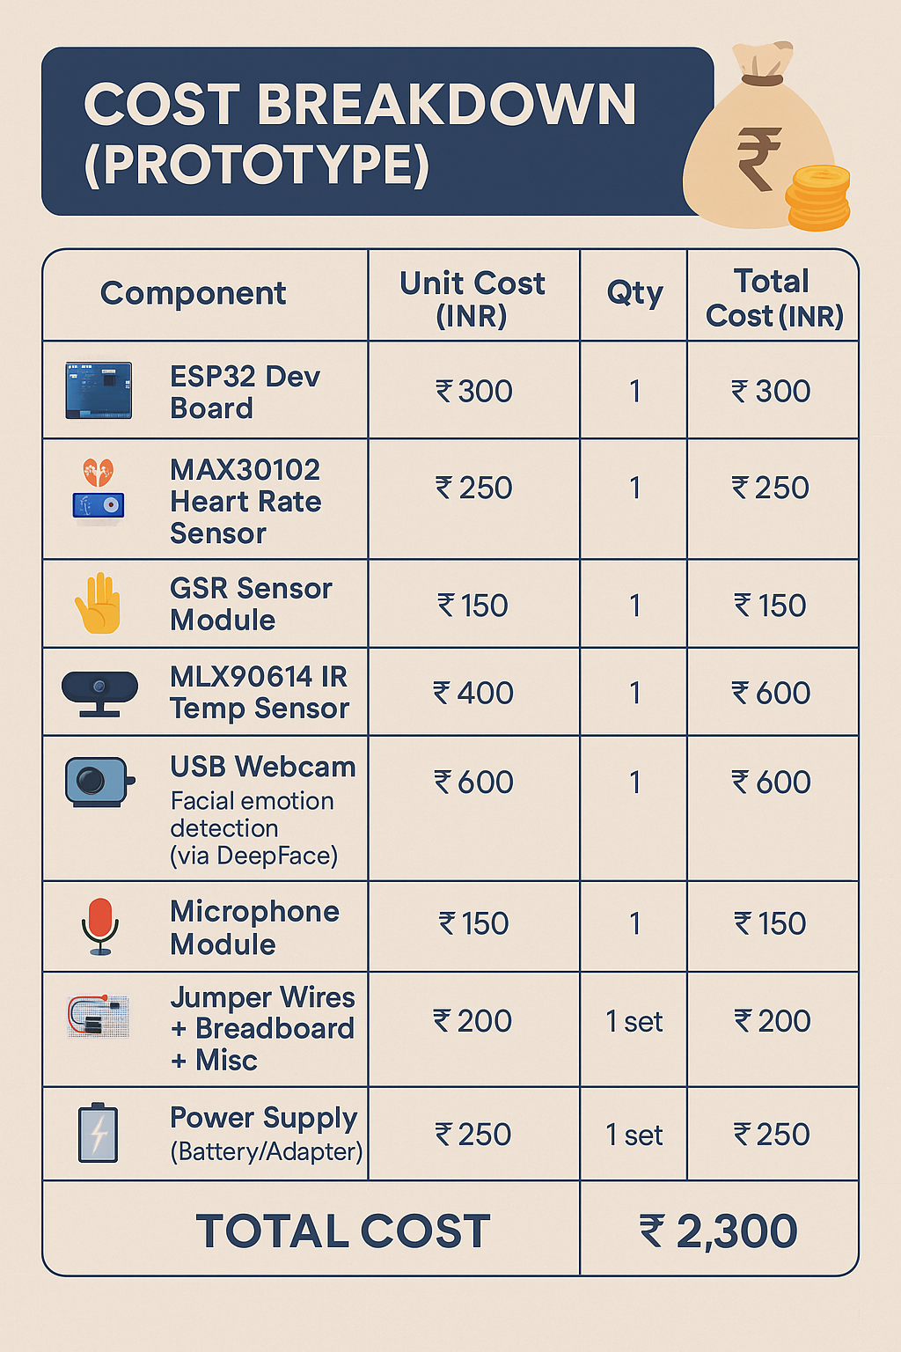

Cost Breakdown (Prototype)
Component | Unit Cost (INR) | Qty | Total Cost (INR) | Purpose
ESP32 Dev Board | ₹300 | 1 | ₹300 | Controller for sensors and communication
MAX30102 Heart Rate Sensor | ₹250 | 1 | ₹250 | HR & HRV detection
GSR Sensor Module | ₹150 | 1 | ₹150 | Stress detection via skin conductivity
MLX90614 IR Temp Sensor | ₹400 | 1 | ₹400 | Skin & ambient temperature sensing
USB Webcam | ₹600 | 1 | ₹600 | Facial emotion detection (via DeepFace)
Microphone Module | ₹150 | 1 | ₹150 | Voice tone/emotion input
Jumper Wires + Breadboard + Misc | ₹200 | 1 set | ₹200 | Wiring & prototyping accessories
Power Supply (Battery/Adapter) | ₹250 | 1 | ₹250 | Powering ESP32 and sensors
🧠 Software/Cloud Costs (₹0 – All Free/Open Source):
DeepFace : Open-source
Flask / Streamlit: Free
Google Calendar API / Firebase (Free Tier): ₹0

Slide 15
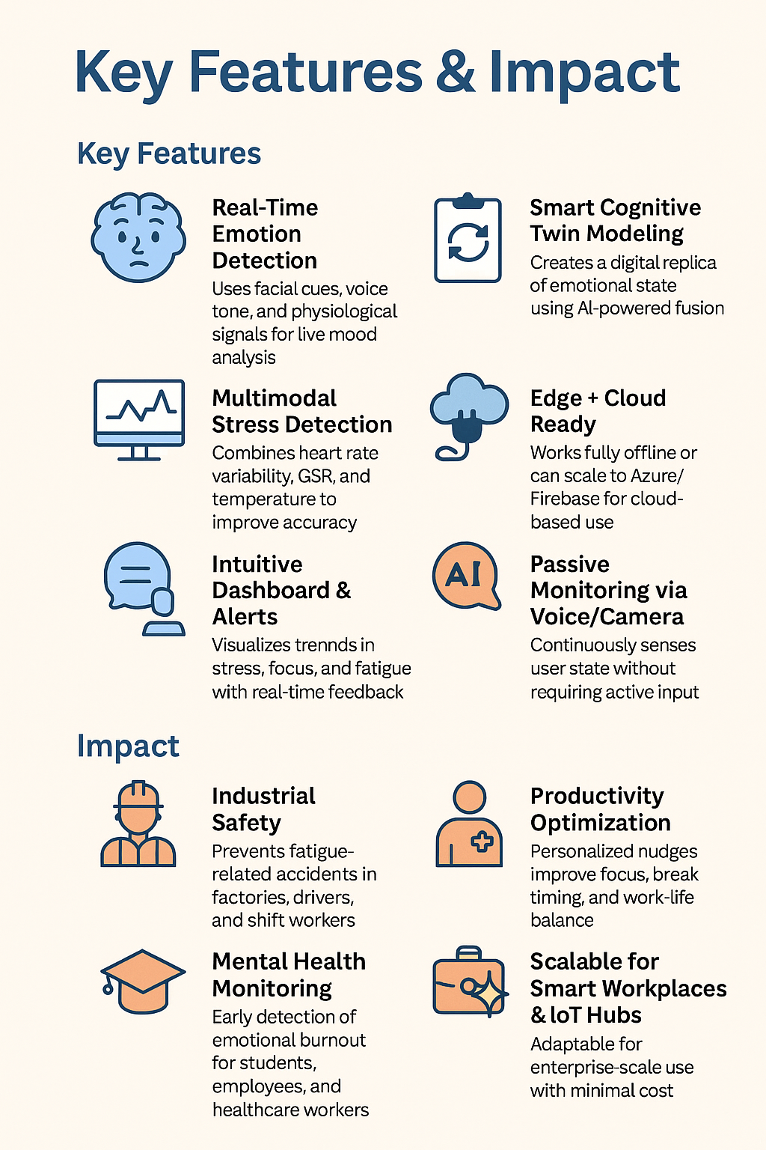
Key Features & Impact
✅ Key Features
🧠 Real-Time Emotion Detection Uses facial cues, voice tone, and physiological signals for live mood analysis.
❤️ Multimodal Stress Detection Combines heart rate variability, GSR, and temperature to improve accuracy.
📲 Smart Cognitive Twin Modeling Creates a digital replica of emotional state using AI-powered fusion.
📊 Intuitive Dashboard & Alerts Visualizes trends in stress, focus, and fatigue with real-time feedback.
🔌 Edge + Cloud Ready Works fully offline or can scale to Azure/Firebase for cloud-based use.
🎙️ Passive Monitoring via Voice/Camera Continuously senses user state without requiring active input.
💬 Explainable AI SHAP-based model transparency to build trust and accountability.
🌍 Impact
🏭 Industrial Safety Prevents fatigue-related accidents in factories, drivers, and shift workers.
🧑‍⚕️ Mental Health Monitoring Early detection of emotional burnout for students, employees, and healthcare workers.
🎓 Educational Wellness Helps track cognitive load in students during learning or exams.
💼 Productivity Optimization Personalized nudges improve focus, break timing, and work-life balance.
🌐 Scalable for Smart Workplaces & IoT Hubs Adaptable for enterprise-scale use with minimal cost.

Slide 16
Conclusion
What is Mentis Mirror?
An AI-powered cognitive digital twin that detects emotional states in real time using facial expressions, voice tone, and physiological signals — enhancing safety, wellness, and productivity.
🔍 Core Features
Real-time facial, voice & stress-based emotion detection
Multimodal AI fusion model with SHAP explainability
Offline + cloud-ready architecture (ESP32, Pi, Flask, Streamlit)
Smart alerts, trend visualizations & personalized insights
Impact Areas
Industrial Safety: Prevents fatigue-based accidents
Mental Health: Early burnout detection for professionals/students
Productivity: Data-driven nudges to optimize daily performance

Slide 17
☺ THANK YOU ☺

